Slide 1
Chapter 17
How to work with functions, closures, and modules

Slide 2
Objectives (part 1)
Applied
Use default parameters and rest parameters in your functions.
Use closures, IIFEs, the module pattern, and ES modules in your applications.
Knowledge
Describe how default parameters work.
Distinguish between the rest operator and the spread operator.
Describe how the this keyword works in arrow functions when compared to function expressions and function declarations.
Describe how the scope chain works in JavaScript.
Describe the creation and use of closures, including how to use closures to create private state.

Slide 3
Objectives (part 2)
Describe the creation and use of IIFEs, including how to use an IIFE to create private state for an object literal.
Describe the use of the module pattern.
Describe the creation and use of namespaces.
Describe the use of ES modules.

Slide 4
A function declaration
The syntax
function functionName(parameters) {
// statements that run when the function is executed
}
An example
function $(selector) {
return document.querySelector(selector);
}

Slide 5
A function expression
The syntax
const constantName = function(parameters) {
// statements that run when the function is executed
};
An example
const $ = function(selector) {
return document.querySelector(selector);
};

Slide 6
An arrow function
The full syntax
const constantName = (parameterList) => {
// statements that run when the function is executed
};
An example of the full syntax
const $ = (selector) => {
return document.querySelector(selector);
};
An abbreviated syntax for one parameter and one statement
const constantName = parameter => statement;
An example of the abbreviated syntax
const $ = selector => document.querySelector(selector);

Slide 7
How to call these functions
const email1 = $("#email_1").value;

Slide 8
A function with a default parameter
const calculateTax = (subtotal, taxRate = 0.074) => {
const tax = subtotal * taxRate;
return tax.toFixed(2);
}
Code that calls the function
const tax1 = calculateTax(100);
// tax1 is 7.40
const tax2 = calculateTax(100, 0.087);
// tax2 is 8.70
const tax3 = calculateTax(100, null);
// tax3 is 0.00
const tax4 = calculateTax(100, undefined);
// tax4 is 7.40

Slide 9
An arrow function with a single parameter and a default value
const getPI = (places = 15) => {
return Math.round(Math.PI * (10 ** places) ) /
(10 ** places);
};
Code that calls the function
const pi = getPI(); // pi is 3.141592653589793
const pi2 = getPI(4); // pi2 is 3.1416

Slide 10
A function with two parameters that have default values
const toPlaces = (num, places = 2, type = "round") => {
if (type == "floor") {
return Math.floor(num * (10 ** places) ) /
(10 ** places);
} else if (type == "ceil") {
return Math.ceil(num * (10 ** places) ) / (10 ** places);
} else {
return Math.round(num * (10 ** places) ) /
(10 ** places);
}
};
Code that calls the function
const num1 = toPlaces(5.22873); // num1 is 5.23
const num2 = toPlaces(5.22873, 4); // num2 is 5.2287
const num3 = toPlaces(5.22873, 4, "ceil"); // num3 is 5.2288
const num4 = toPlaces(5.22873, "floor"); // num4 is NaN
const num5 = toPlaces(5.22873, undefined, "floor");
// num5 is 5.22

Slide 11
An arrow function with a rest parameter
const calculateTaxAll = (taxRate, ...subtotals) => {
let tax = 0;
for (let subtotal of subtotals) {
tax += subtotal * taxRate;
}
return tax.toFixed(2);
}

Slide 12
How to call the arrow function
With a list of parameters
const tax1 = calculateTaxAll(0.074, 100); // tax1 is 7.40
const tax2 = calculateTaxAll(0.074, 100, 200); // tax2 is 22.20
const tax3 = calculateTaxAll(0.074, 100, 200, 400, 500); // tax3 is 88.80
With a single spread operator
const taxRateAndAmounts = [0.074, 100, 200, 400, 500];
const tax4 = calculateTaxAll(...taxRateAndAmounts); // tax4 is 88.80
With multiple spread operators
const rateAndAmounts = [0.074, 100];
const moreAmounts = [200, 400];
const tax5 = calculateTaxAll(
...rateAndAmounts, ...moreAmounts, 500);
// tax5 is 88.80

Slide 13
A regular function that uses the arguments property (not recommended)
const calculateTaxAll = function() {
const taxRate = arguments[0];
let tax = 0;
for (let i = 1; i < arguments.length; i++) {
const subtotal = arguments[i];
tax += subtotal * taxRate;
}
return tax.toFixed(2);
}

Slide 14
The value of the this keyword in a regular function
How function is called Value of the this keyword
Normal function call Undefined in strict mode. Otherwise, the window object.
As a method of an object The object that contains the function.
As an event handler The object that raised the event such as a button that was clicked.

Slide 15
Methods of a function for specifying the value of this
Method Description
call(thisArg[, arg1]...) Calls a function, sets the value of this for the function, and passes zero or more values to the function.
apply(thisArg, argArray) Calls a function, sets the value of this for the function, and passes an array of values to the function.
bind(thisArg[, arg1]...) Binds the value of this to a function. Then, the value of this can’t be changed later.

Slide 16
How to use the call() method to “borrow” a method from the Array object
const displayArguments = function() {
const display =
Array.prototype.join.call(arguments, " ");
console.log(display);
};
displayArguments("Michael", "R", "Murach");
// Displays "Michael R Murach"

Slide 17
How to use the apply() method to pass an array to the Math.max() method
const scores = [89,78,99,92,87];
const highScore = Math.max.apply(null, scores);
// highScore is 99

Slide 18
Terms related to functions
call (invoke) a function
function declaration
function expression
arrow function
arrow operator
rest operator
rest parameter
spread operator

Slide 19
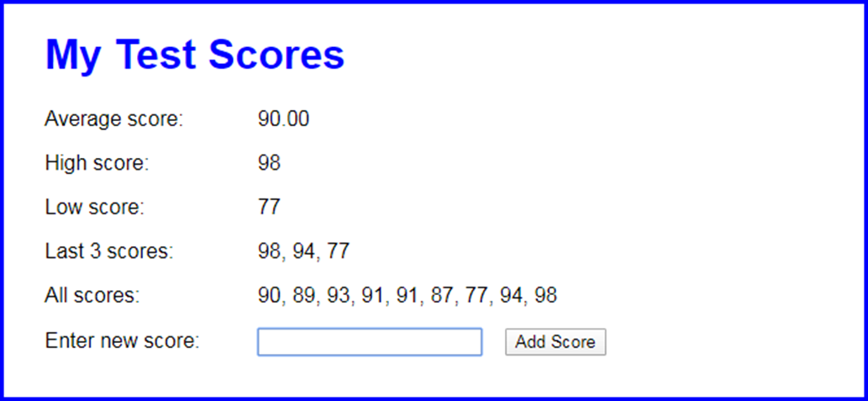
The Test Scores application

Slide 20
The HTML for the Test Scores application (part 1)
<main>
<h1>My Test Scores</h1>
<div>
<label>Average score:</label>
<label id="avg"></label>
</div>
<div>
<label>High score:</label>
<label id="high"></label>
</div>
<div>
<label>Low score:</label>
<label id="low"></label>
</div>
<div>
<label>Last 3 scores:</label>
<label id="last"></label>
</div>

Slide 21
The HTML for the Test Scores application (part 2)
<div>
<label>All scores:</label>
<span id="all"></span>
</div>
<div>
<label for="score">Enter new score:</label>
<input type="text" id="score">
<input type="button" id="add_score"
value="Add Score">
<p></p>
</div>
</main>
Some of the CSS for the Test Scores application
p {
color: red;
}

Slide 22
The JavaScript for the Test Scores app (part 1)
"use strict";
const isInvalid =
score => isNaN(score) || score < 1 || score > 100;
const getAverage = arr => {
const total =
arr.reduce( (tot, val) => tot + val, 0 );
return total/arr.length;
};
const getLast = (arr, num = 3) => {
const copy = [...arr];
copy.reverse();
return copy.slice(0, num);
}

Slide 23
The JavaScript for the Test Scores app (part 2)
$(document).ready( () => {
const scores = [];
$("#add_score").click( function() {
const score = parseFloat($("#score").val());
if (isInvalid(score)) {
$(this).next().text(
"Score must be between 1 and 100.");
}
else {
$(this).next().text("");
// add to array
scores.push(score);

Slide 24
The JavaScript for the Test Scores app (part 3)
// update calculations
$("#high").text(Math.max(...scores));
$("#low").text(Math.min(...scores));
$("#last").text(getLast(scores).join(", "));
$("#avg").text(
getAverage(scores).toFixed(2));
$("#all").text(scores.join(", "));
}
// get text box ready for next entry
$("#score").val("");
$("#score").focus();
});
// set focus on initial load
$("#score").focus();
});

Slide 25
An example that illustrates a closure
const createClickCounter = () => { // outer function
let count = 0; // local variable
const clickCounter = evt => { // inner function
count++;
console.log(evt.currentTarget.id + " count is " + count);
};
return clickCounter;
};
$(document).ready( () => {
$("#first_button").click(createClickCounter());
$("#second_button").click(createClickCounter());
});

Slide 26
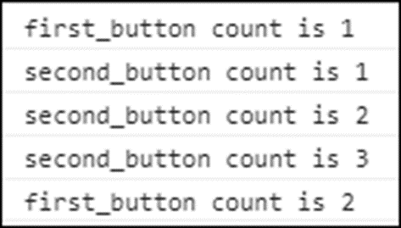
The Console panel after clicking the two buttons several times

Slide 27
A function that creates a closure with private state
const createSlideShow = () => {
// private variables and constants
let timer = null;
let play = true;
let speed = 2000;
const nodes = { image: null, caption: null };
const img = { cache: [], counter: 0 };
// private functions
const stopSlideShow = () => { ... };
const displayNextImage = () => { ... };
return { // a public object
loadImages(slides) { ... }, // public method #1
startSlideShow(image, caption) { ... }, // public method #2
getToggleHandler(){ ... } // public method #3
};
};

Slide 28
Code that creates and uses the slide show object returned by the function
// create the slideShow object
const slideShow = createSlideShow();
// call a public method from it
slideShow.loadImages(slides);

Slide 29
An arrow function that accesses the current object and the event target
const item = {
rate: 0.075,
calc(subtotal) {
return (subtotal + (subtotal * this.rate)).toFixed(2);
},
displayFullPrice(subtotal) {
return evt => {
console.log(
`Full price for ${evt.currentTarget.id} = ${
this.calc(subtotal)}`);
};
}
};

Slide 30
A regular function that performs the same task (not recommended)
const item = {
rate: 0.075,
calc(subtotal) {
return (subtotal + (subtotal * this.rate)).toFixed(2);
},
displayFullPrice(subtotal) {
const me = this; // store the current object as 'me'
return function() {
console.log( // 'this' accesses current event target
`Full price for ${this.id} = ${me.calc(subtotal)}`);
};
}
};

Slide 31
Code that attaches the inner function as an event handler for a button
$("#camera").click(item.displayFullPrice(125));
The text that’s displayed when you click the button
Full price for camera = 134.38

Slide 32
Terms related to closures
scope chain
in scope
out of scope
closure
private state

Slide 33

The Slide Show application in the browser

Slide 34
The HTML for the Slide Show application
<main>
<h1>Fishing Slide Show</h1>
<p><img id="image"></p>
<h2 id="caption"></h2>
<p><input type="button" id="play_pause"
value="Pause"></p>
</main>

Slide 35
The lib_slide_show.js file for the Slide Show app (part 1)
"use strict";
const createSlideShow = () => {
// private variables and constants
let timer = null;
let play = true;
let speed = 2000;
const nodes = { image: null, caption: null };
const img = { cache: [], counter: 0 };
// private methods
const stopSlideShow = () => clearInterval(timer);
const displayNextImage = () => {
img.counter = ++img.counter % img.cache.length;
const image = img.cache[img.counter];
nodes.image.attr("src", image.src);
nodes.image.attr("alt", image.alt);
nodes.caption.text(image.alt);
};

Slide 36
The lib_slide_show.js file for the Slide Show app (part 2)
// public methods that access private state
return {
loadImages(slides) {
for (let slide of slides) {
const image = new Image();
image.src = "images/" + slide.href;
image.alt = slide.title;
img.cache.push(image);
}
return this; // object for slide show
},
startSlideShow(image, caption) {
if(image && caption) {
nodes.image = image;
nodes.caption = caption;
}
displayNextImage();
timer = setInterval(displayNextImage, speed);
return this; // object for slide show
},

Slide 37
The lib_slide_show.js file for the Slide Show app (part 3)
getToggleHandler() {
return evt => {
if (play) {
stopSlideShow();
} else {
// call method from object
this.startSlideShow();
}
const button = evt.currentTarget;
button.value =
(play) ? "Resume" : "Pause";
play = !play; // toggle play flag
};
}
};
};

Slide 38
The slide_show.js file for the Slide Show app
"use strict";
$(document).ready( () => {
// create the slideShow object
const slideShow = createSlideShow();
const slides = [
{href:"release.jpg", title:"Catch and Release"},
{href:"deer.jpg", title:"Deer at Play"},
{href:"hero.jpg", title:"The Big One!"},
{href:"bison.jpg", title:"Roaming Bison"}
];
$("#play_pause").click(slideShow.getToggleHandler());
slideShow.loadImages(slides)
.startSlideShow($("#image"), $("#caption"));
});

Slide 39
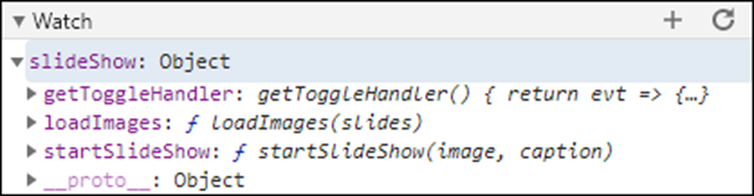
The slideShow object for the Slide Show app in the Watch pane of the Chrome developer tools

Slide 40
A function expression that is defined and then invoked
const sayHello = function() { // define function
console.log("Hello");
};
sayHello(); // invoke function
An immediately invoked function expression (IIFE)
(function() { // define and invoke function
console.log("Hello");
})();
An immediately invoked arrow function
( () => { // define and invoke function
console.log("Hello");
})();

Slide 41
Two ways to code the parentheses of an IIFE
(function() {
console.log ("Hello");
} ) ();
(function() {
console.log ("Hello");
} () );

Slide 42
An IIFE…
Helps keep variables, constants, and functions out of global scope.
Helps prevent name conflicts.
Can be used to create private state for an object.

Slide 43
An IIFE that prevents name conflicts
const result = ( () => {
const message = "Thanks!";
return message;
})();
console.log(result); // displays "Thanks!"
const message = "Have a great weekend!";
// no name conflict
console.log(message); // displays "Have a great weekend!"

Slide 44
The pros and cons of object literals vs closures
Type Pros and cons
Object literal Pros: The library creates the object so the programmer can use it.
Cons: All of the object’s properties and methods are public.
Closure Cons: The programmer must call a function to create an object before being able to use it.
Pros: The objects created by calling the function can have private state.

Slide 45
A module pattern that creates an object with private state
const slideShow = ( () => {
// private variables and constants
let timer = null;
let play = true;
let speed = 2000;
const nodes = { image: null, caption: null };
const img = { cache: [], counter: 0 };
// private methods
const stopSlideShow = () => { ... }
const displayNextImage = () => { ... }
// public methods
return {
loadImages(slides) { ... },
startSlideShow(image, caption) { ... },
getToggleHandler(){ ... }
};
})(); // Invoke the IIFE to create the object

Slide 46
How to create and use a namespace
An object literal that’s used as a namespace
const myapp = {};
How to ensure you don’t overwrite an existing namespace
var myapp = myapp || {}; // must use var
Code that adds a slideShow object to the myapp namespace
myapp.slideShow = ( () => {
...
})(); // Invoke the IIFE to create the object
A statement that uses the slideshow object of the myapp namespace
myapp.slideShow.loadImages(slides);

Slide 47
Terms related to the module pattern
module pattern
immediately invoked function expression (IIFE)
singleton
module
namespace

Slide 48
A module file that exports three functions
// variables and constants
let timer = null;
let play = true;
let speed = 2000;
const nodes = { image: null, caption: null };
const img = { cache: [], counter: 0 };
// functions
const stopSlideShow = () => { ... };
const displayNextImage = () => { ... };
export const loadImages = (slides) => { ... };
export const startSlideShow =
(image, caption) => { ... };
export const getToggleHandler = () => { ... };
Another way to export the three functions
export { loadImages, startSlideShow, getToggleHandler };

Slide 49
A module that imports and uses two functions
import { loadImages, startSlideShow }
from './lib_slide_show.js';
$(document).ready( () => {
...
// load the images and start the slide show
loadImages(slides);
startSlideShow($("#image"), $("#caption"));
// speed = 200; // Error: speed is not defined
// stopSlideShow(); // Error: stopSlideShow not defined
});

Slide 50
Script elements that declare the modules
<script src="lib_slide_show.js" type="module"></script>
<script src="slide_show.js" type="module"></script>
A script element that declares inline JavaScript as a module
<script src="lib_slide_show.js" type="module"></script>
<script type="module">
import { loadImages, startSlideShow }
from './lib_slide_show.js';
// load the images and start the slide show
loadImages(slides);
startSlideShow($("#image"), $("#caption"));
</script>

Slide 51
A module…
Must be run from a server. If you try to run a module from the file system, JavaScript throws errors due to module security requirements.
Uses strict mode automatically. As a result, you don’t need to code the “use strict” declaration at the top of a module.
Uses the defer attribute of the script element automatically. As a result, there’s no need to code this attribute when loading a module.
Is only executed once. That’s true even if it has been referenced by multiple script elements.
Is imported into the scope of a single script. In other words, it isn’t imported into global scope. As a result, you can only access imported items in the script they are imported into.

Slide 52
How to rename imports and exports
Code that renames two imported items
import { loadImages as slideShowLoadImages,
startSlideShow as slideShowStart }
from './lib_slide_show.js';
Code that renames three exported items
export { loadImages as load,
startSlideShow as start,
getToggleHandler as getToggle };

Slide 53
How to create and use a module object
import * as slideShow from './lib_slide_show.js';
$(document).ready( () => {
const slides = [...];
slideShow.load(slides);
slideShow.start($("#image"), $("#caption"));
});

Slide 54
How to use imports and exports with classes
Code that exports two classes
export { Trip, Trips };
class Trip {...}
class Trips {...}
Code that imports two classes
import { Trip, Trips } from './lib_trips.js';
$(document).ready( () => {
const trips = new Trips();
const trip = new Trip("Seattle", 100, 3.5);
});
Code that declares the two files that use the classes as modules
<script src="lib_trips.js" type="module"></script>
<script src="trips.js" type="module"></script>

Slide 55
The HTML for the Slide Show 2.0 application
<body>
<main>
<h1>Fishing Slide Show</h1>
<p><img id="image"></p>
<h2 id="caption"></h2>
<p><input type="button" id="play_pause"
value="Pause"></p>
</main>
<script
src="https://code.jquery.com/jquery-3.4.1.slim.min.js">
</script>
<script src="lib_slide_show.js" type="module">
</script>
<script src="slide_show.js" type="module"></script>
</body>

Slide 56
The lib_slide_show.js file for the Slide Show 2.0 application (part 1)
export { loadImages, startSlideShow, getToggleHandler };
// private variables and constants
let timer = null;
let play = true;
let speed = 2000;
const nodes = { image: null, caption: null };
const img = { cache: [], counter: 0 };
// private functions
const stopSlideShow = () => clearInterval(timer);
const displayNextImage = () => {
img.counter = ++img.counter % img.cache.length;
const image = img.cache[img.counter];
nodes.image.attr("src", image.src);
nodes.image.attr("alt", image.alt);
nodes.caption.text(image.alt);
};

Slide 57
The lib_slide_show.js file for the Slide Show 2.0 application (part 2)
// public functions
const loadImages = (slides) => {
for (let slide of slides) {
const image = new Image();
image.src = "images/" + slide.href;
image.alt = slide.title;
img.cache.push(image);
}
}
const startSlideShow = (image, caption) => {
if(image && caption) {
nodes.image = image;
nodes.caption = caption;
}
displayNextImage();
timer = setInterval(displayNextImage, speed);
}

Slide 58
The lib_slide_show.js file for the Slide Show 2.0 application (part 3)
const getToggleHandler = () => {
return evt => {
if (play) {
stopSlideShow();
} else {
startSlideShow();
}
const button = evt.currentTarget;
button.value = (play) ? "Resume" : "Pause";
play = !play; // toggle play flag
};
}

Slide 59
The slide_show.js file for the Slide Show 2.0 app
import * as slideShow from './lib_slide_show.js';
$(document).ready( () => {
// define the slides
const slides = [
{href:"release.jpg", title:"Catch and Release"},
{href:"deer.jpg", title:"Deer at Play"},
{href:"hero.jpg", title:"The Big One!"},
{href:"bison.jpg", title:"Roaming Bison"}
];
// attach the event handler for the Play/Pause button
$("#play_pause").click(slideShow.getToggleHandler());
// load the images and start the slide show
slideShow.loadImages(slides);
slideShow.startSlideShow($("#image"), $("#caption"));
});

Slide 60
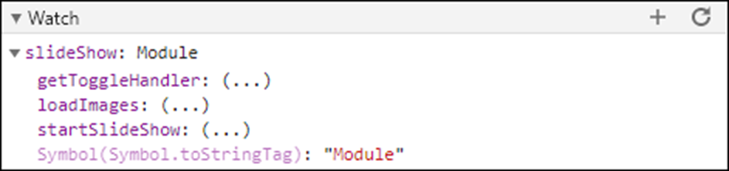
The slideShow object for the Slide Show 2.0 app in the Watch pane of the Chrome developer tools

